Slide 1
Introduction to the SHS Supplier Portal
IVALUA

Slide 2
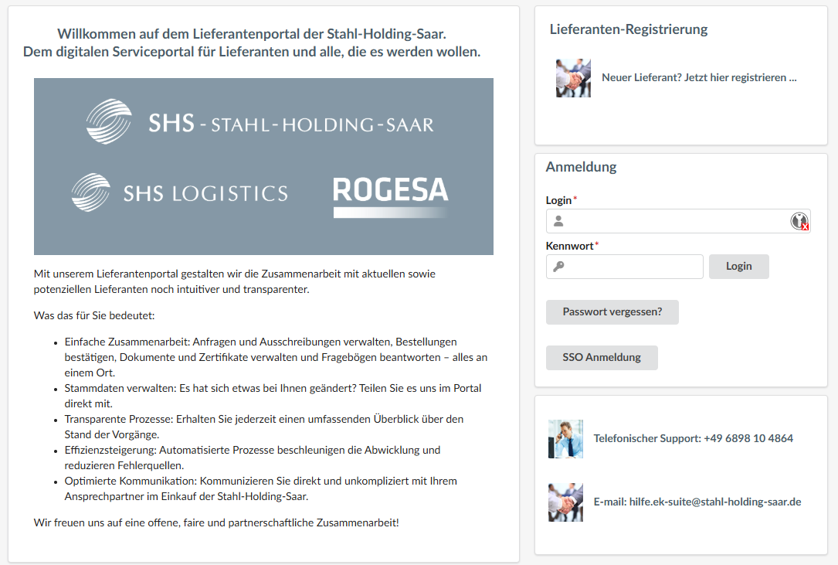
What is Ivalua?
Ivalua is our new procurement platform, through which our procurement processes will be managed in the future. It will help both us and you, as a supplier, reduce administrative burdens and save costs. If you are interested in becoming part of our sustainable supply chain and working with us to shape the path toward green steel, we look forward to hearing from you via email at: einkauf@stahl-holding-saar.de.

Slide 3
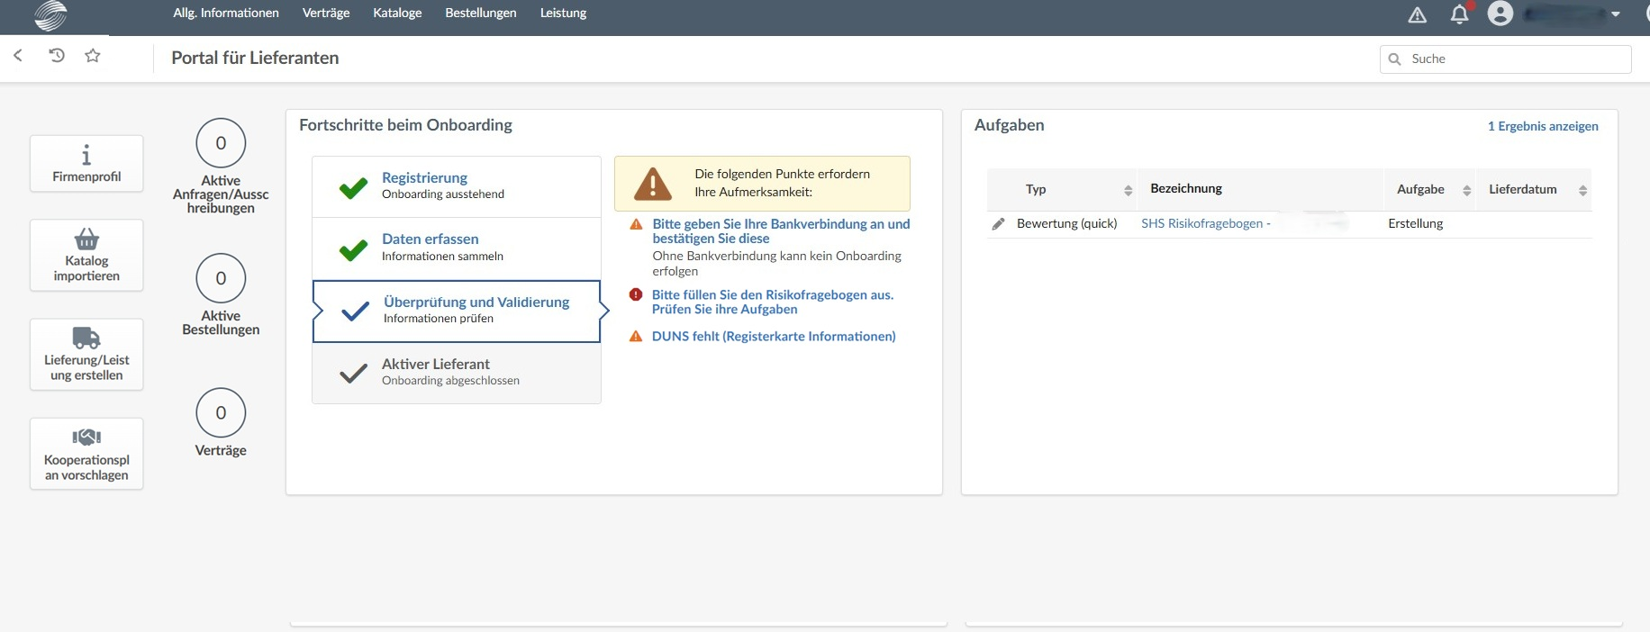
Overview homepage
The homepage displays an overview of the portal. On the right, you'll see the tasks you currently need to complete. In the center, you'll see your progress in the onboarding process and which additional details are still missing.

Slide 4
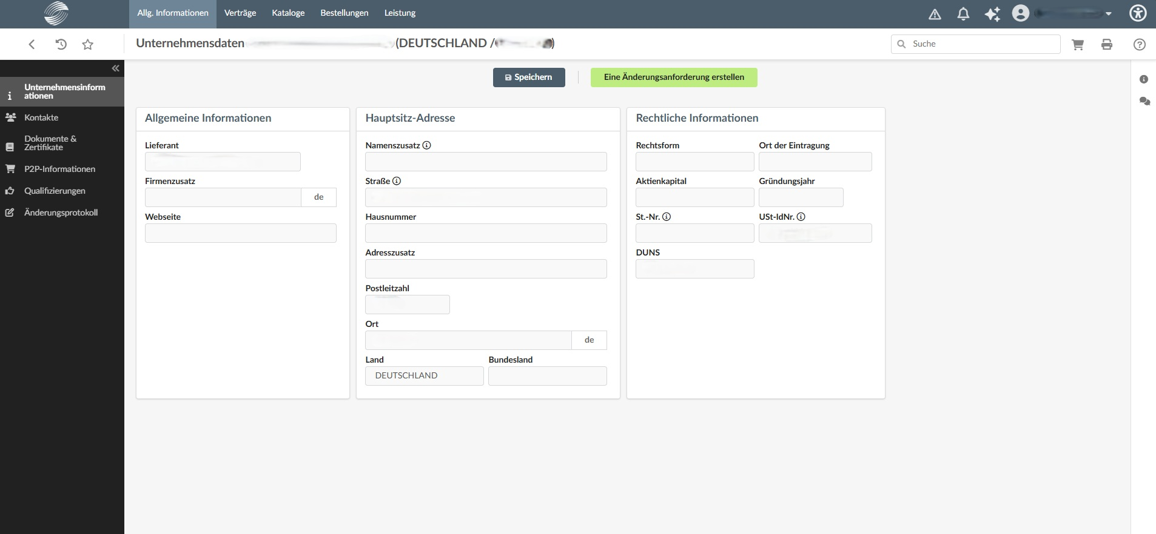
As a supplier, what can I do on the supplier portal?
View and edit master data
On our supplier portal, you, as a supplier, can view and edit your master data. Click on your company profile on the home page to access your master data.

Slide 5
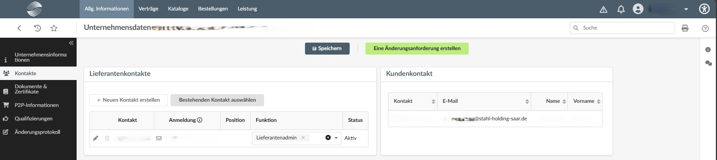
As a supplier, what can I do on the supplier portal?
View and edit contact information
Contact information can be added, edited, or deleted. You can also view the responsible buyers at Stahl-Holding-Saar.

Slide 6
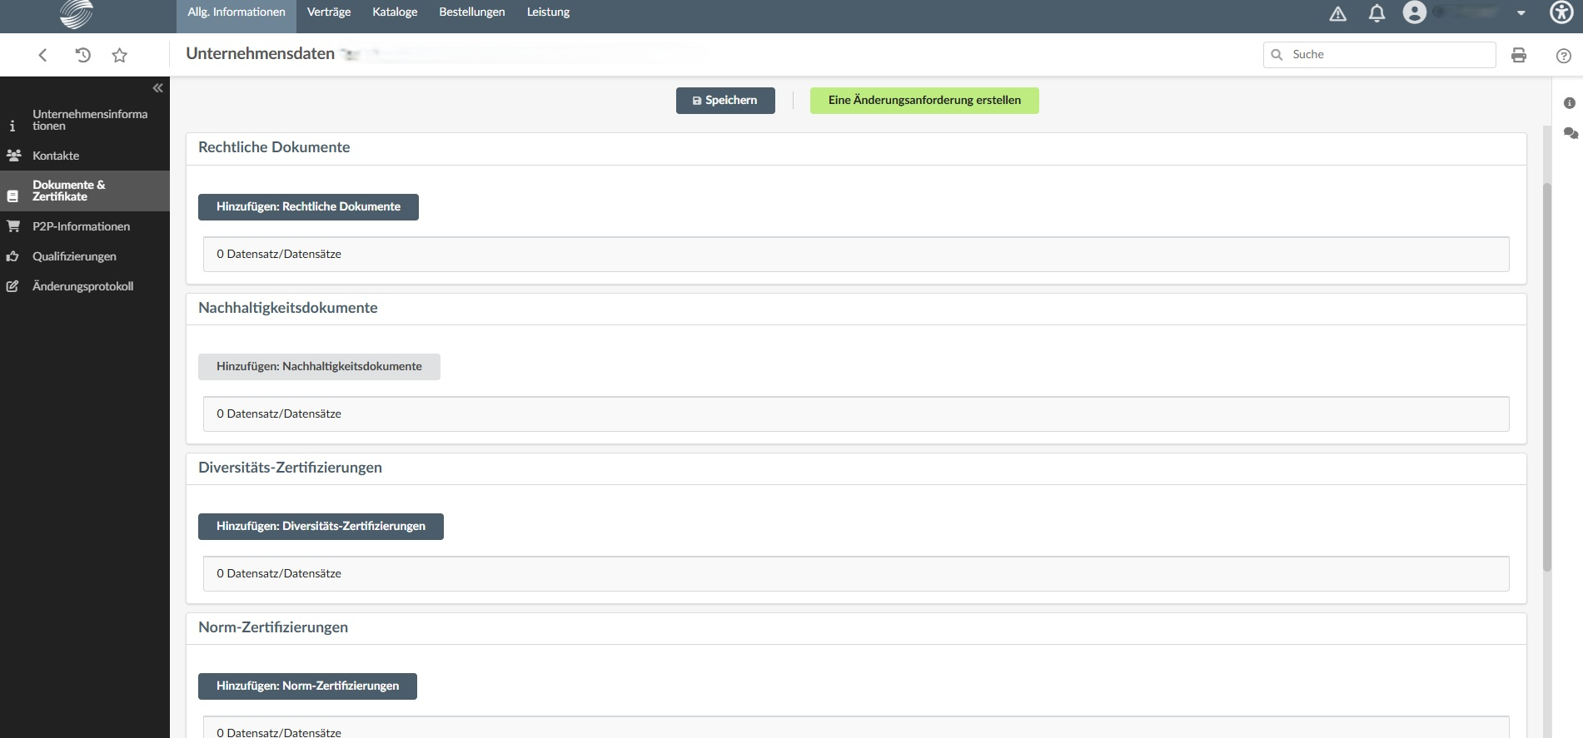
As a supplier, what can I do on the supplier portal?
Add certificates and documents
You can share many types of certificates and documents with us.

Slide 7
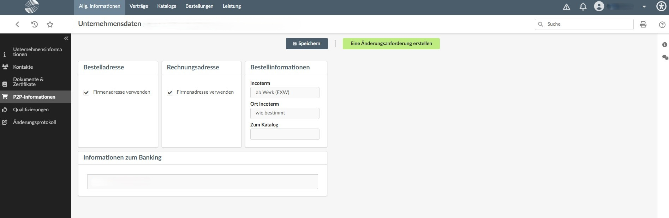
As a supplier, what can I do on the supplier portal?
Update bank information
It's easy to keep your bank account information up to date in the supplier portal.

Slide 8
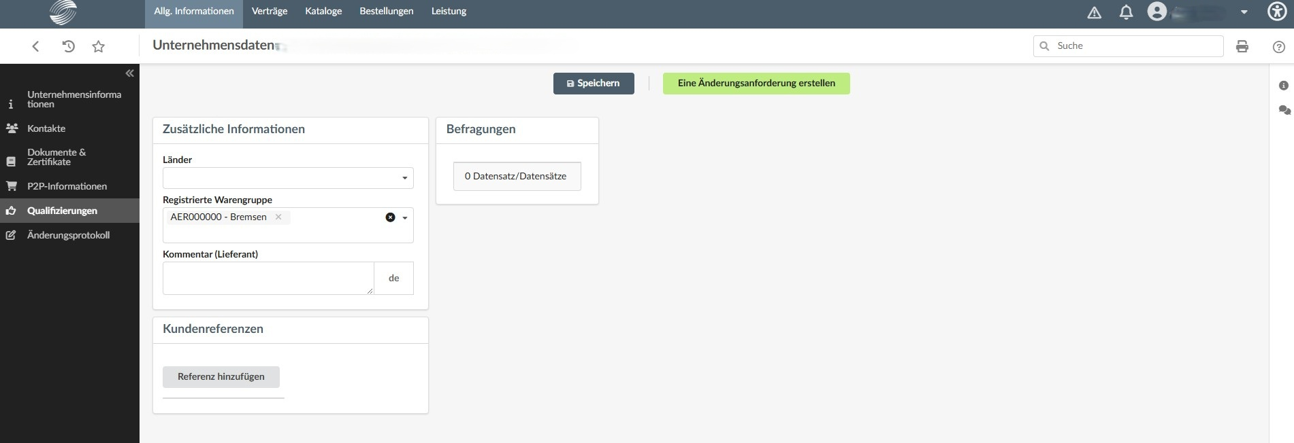
As a supplier, what can I do on the supplier portal?
Edit commodity groups
What other commodity groups do you supply? Please let us know in the “Qualifications” tab using our product commodity structure.

Slide 9
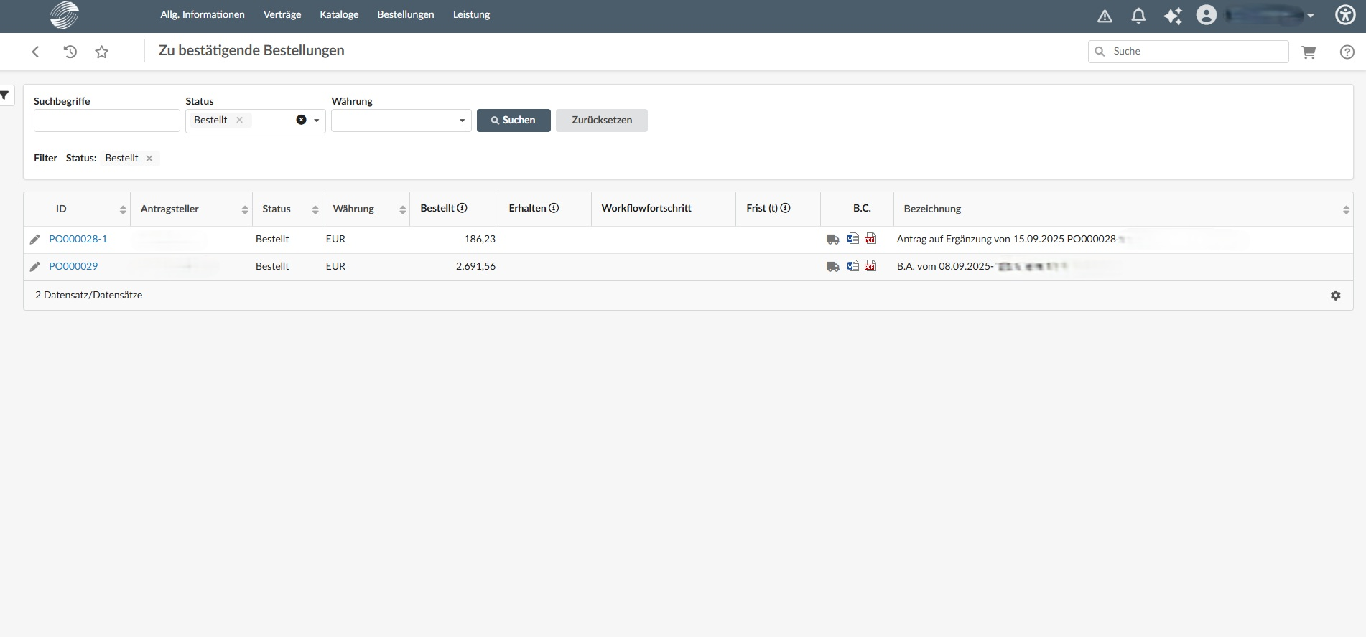
As a supplier, what can I do on the supplier portal?
View and confirm orders
Sehen Sie aktuelle Bestellungen ein und bestätigen Sie diese. Auch abgeschlossene Bestellungen finden Sie hier.

Slide 10
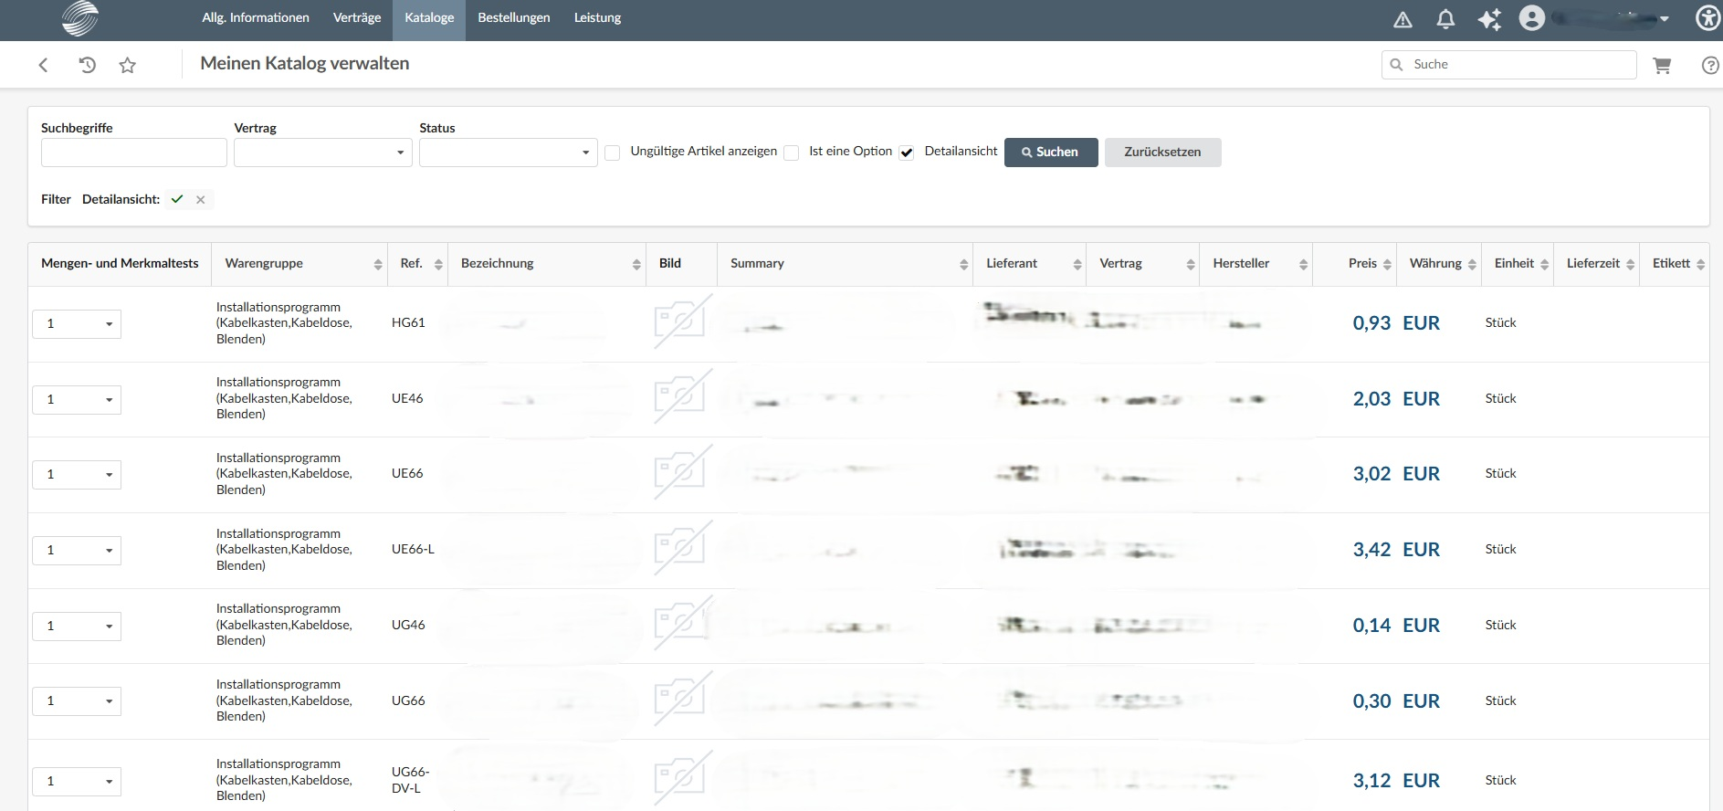
As a supplier, what can I do on the supplier portal?
Catalog management
Our supplier portal allows you to link and manage catalogs.

Slide 11
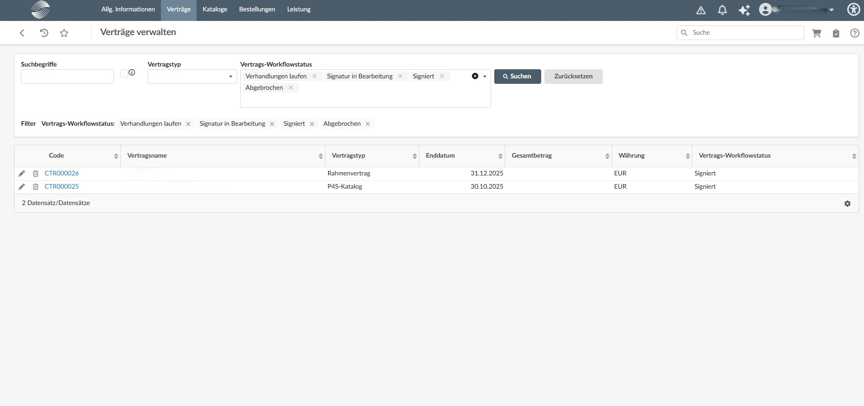
As a supplier, what can I do on the supplier portal?
Contract management
All contracts concluded with us are available to you in one place on the supplier portal, where you can view them at any time.

Slide 12
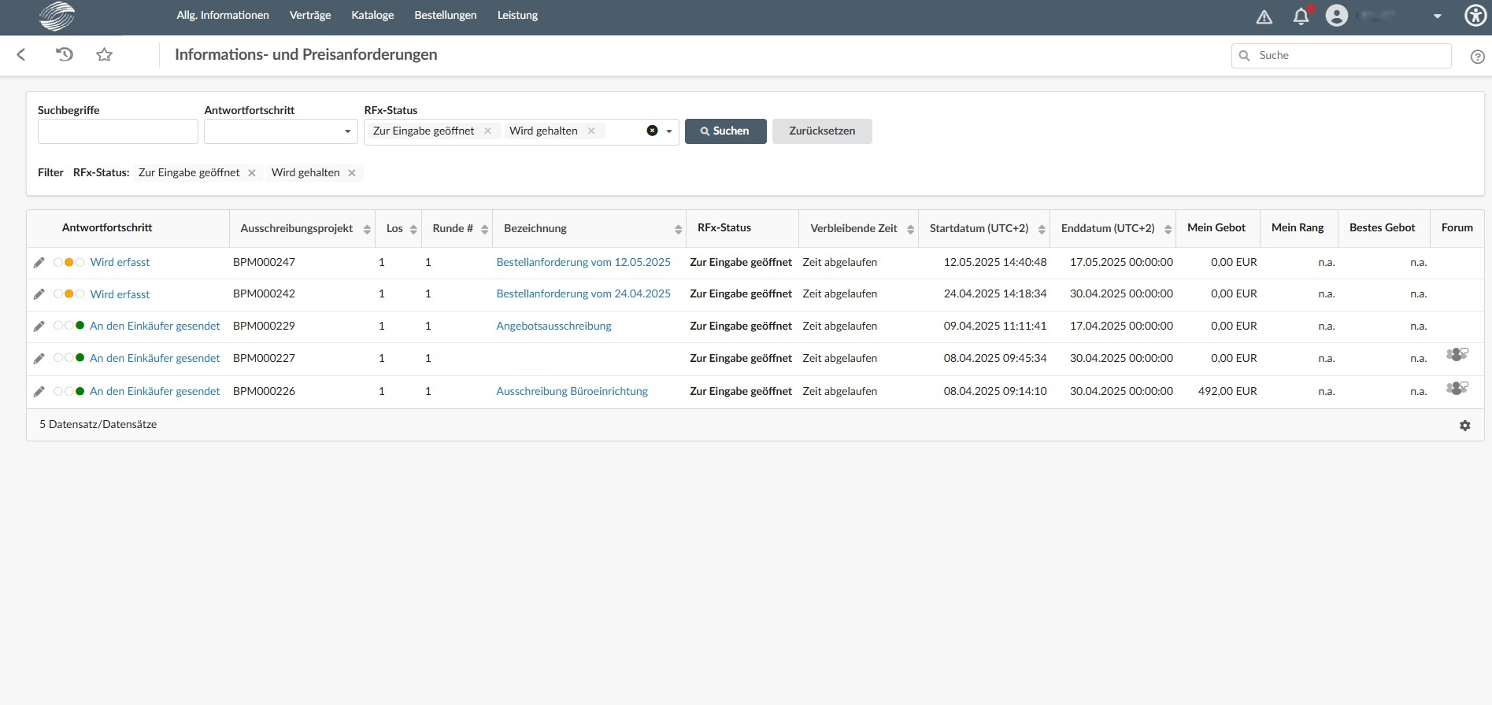
As a supplier, what can I do on the supplier portal?
RFP and RFQ
RFP and RFQs for which you have been selected are available in the supplier portal. You can use this portal to submit or decline bids.

Slide 13
Help and support
If you have any questions about the purchasing process, please feel free to contact the buyer in charge. For technical questions, our support team is available to assist you via email or phone.
hilfe.ek-suite@stahl-holding-saar.de

